Slide 1

SHIELD INSURANCE BUSINESS INSIGHTS
INTRECTIVE BUSINESS INTLLIGENCE DASHBORD FOR REVENUE, CUSTOMER,SALES MODE
DOMAIN : INSURANCE| FUNCTION : CUSTOMER AND SALES MODE ANALYSIS
Presented by Deepak Kumar

Slide 2


TABLE CONTENT
PROBLEM STATEMENT
PROJECT OBJECTIVE
DATASET OVERVIEW
DATAMODEL OVERVIEW
DASHBORAD OVERVIEW
KEY INSIGHTS
STRATEGIC RECOMMENDATION

Slide 3
PROBLEM STATEMENT
Shield Insurance lacked a Centralized analytical solutions to monitor revenue
Performance, customer growth, sales channel effectiveness customer
Demographics, and settlement risk trend, this made its difficult for stakeholder
to identify Business Patterns evaluate sales performance and make data-driven decisions efficiently.
To address this challenge. An interactive Power BI Dashboard was developed to provide real-time business insights across Revenue, Customer Segmentation, Sales Mode, Policy Preference, Age Group based on risk Analysis

Slide 4

Project OBJECTIVE
Develop an Interactive Power BI Dashboard to Analyze:
Revenue Performance
Customer Growth
Sales Mode Effectiveness
Customer Segmentation
Age-Group risk Analysis

Slide 5
DATASET OVERVIEW
DIM_POLICY
Hold Data related to insurance policies
Provide Daily, Monthly Weekly Date Information
DIM_DATE
v
Customer Information like code Dob and city
DIM_CUSTOMER
v
FACT_PREMIUMS
Contains Information Policy holder & Premiums
v
Provide information about policy settellment
FACT_INSTALLMENT

Slide 6
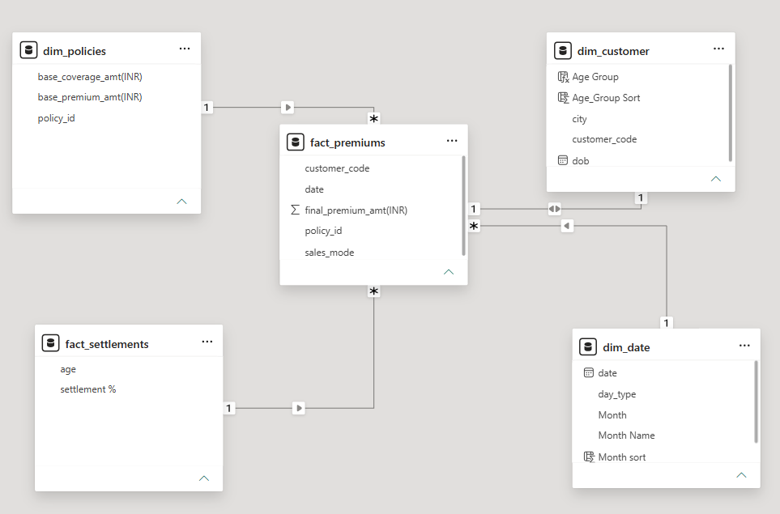
Data Model Overview
The Model fellow Star Schema Design where fact table connected to dimensions table
Design for Analytical Query and Reporting (Power BI)
Ensure easy aggregation, filtering and performance optimization

Slide 7
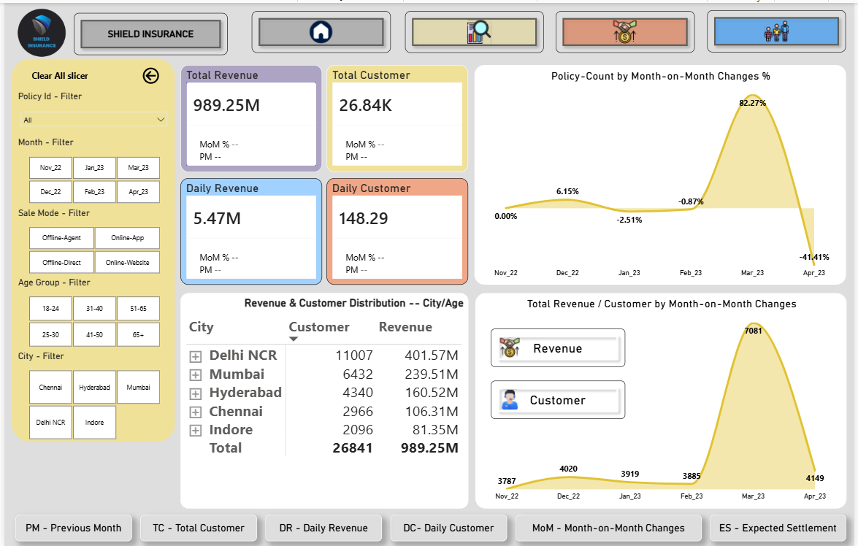

Slide 8
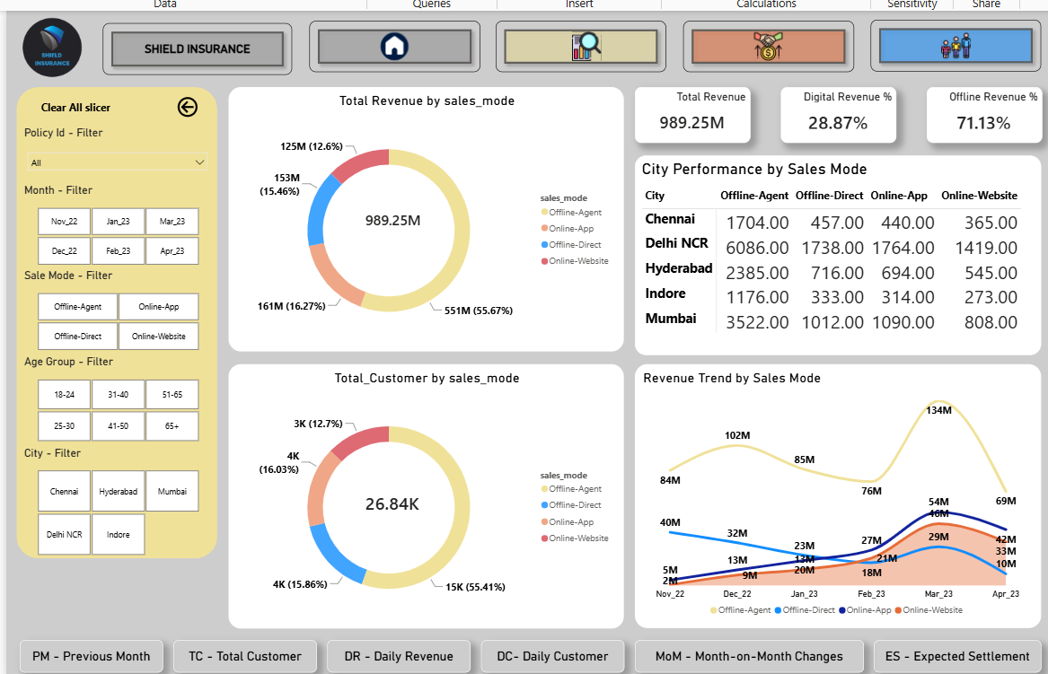

Slide 9
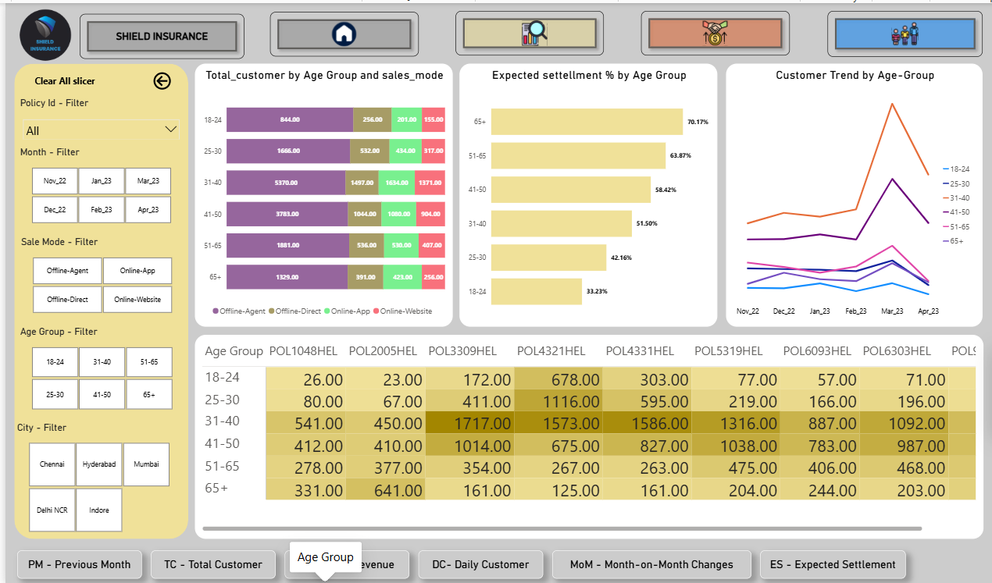

Slide 10

Key Insight
Between November 2022 and April 2023 Shield Insurance Generated Revenue ₹ 989.2M in total revenue and served a customer based of 26.6K customer across multiple cities and age groups
Delhi NCR emerged at the top-performing city, contributing 40.6% of total revenue and 41% of total customer
Mumbai ranked second, contributing 24.2% of total revenue and 23.9% of total customer.
Customer Aged 31-40 represent the largest customer segment, accounting for 38.3% of the total customer base
Followed by 41-50 age group at 23.4% of the total customer base.
Customer Aged 65+ recorded the highest expected settlement rate at 70.4% followed by the 51-65 age group at 63.8% indicating comparatively highly insurance risk among senior customer.
Customer Aged 18-24 showed the strongest preference for the POL4321HEL policy, accounting for 46.4.% of policy selections within this age group Similarly POL4321HEL was the most preferred policy among customer
Age 25-30 representing 36.5% of policy selections among senior citizen aged 65+, POL2005HEL emerged as the most preferred policy accounting for 27.3% of policy selections
Offline-agent was the most preferred sales channel accounting for 55.4% of the total customer base, while online sales channel collectively contributed 28.7% of total customers.
Offline-agent mode generated the highest revenue contribution accounting for 55.7% of total revenue copmpair to other sales channels

Slide 11
Strategic Recommendation
→ To increase overall revenue, Shield Insurance should focus on expanding its customer base in lower-performing cities such as Indore, Hyderabad and Chennai particularly among customer aged 18-30. the analysis indicated a strong positive relationships between customer growth and revenue generation.
→ Shield Insurance Should review and optimize premium pricing strategies for customer aged 51+ due to their competitive while effective balancing risk
→ Shield Insurance should launch targeted marketing campaigns for customer aged 18-30 t promoted the POL4321HEL
Policy as this policy show strong preference within this age group along with comparatively lower settlement risk. Similarly targeted campaigns for senior customer aged 51+ can help improve adoption of the POL2005HEL Policy.
→ since offline-agent is the highest-performing sales channel Shield Insurance should establish monthly pr quarterly customer acquisitions targets for agents and closely monitor their performance at the same time the company should analyze and improve online-app and online-website channels to understand the factor limiting customer acquisitions through digital platform.

Slide 12
Thank you

